Slide 1


Agile and Lean
Important principles for this module
Part 3 – This Module

Slide 2

Agile isn’t easy

Slide 3

Agile is a devolved project management technique.
To work, it needs a capable and specialised development team that can self-manage, communicate well and make effective planning decisions.
Don’t

Slide 4

In this module we will only take the first few steps towards a fully agile approach.
We will focus on iterative development and the creation of useful, high quality software.

Slide 5
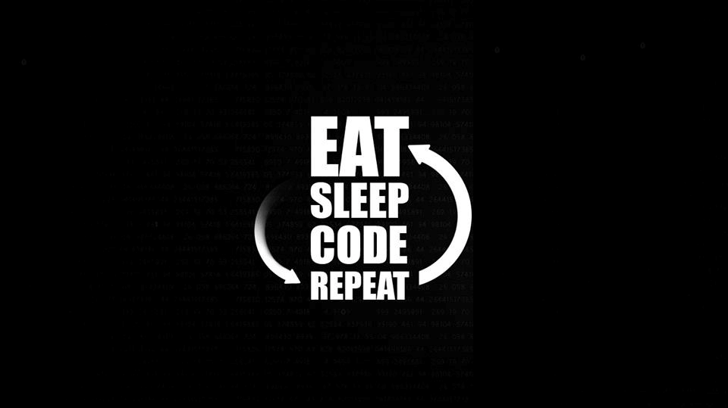
Iterative Development

Slide 6
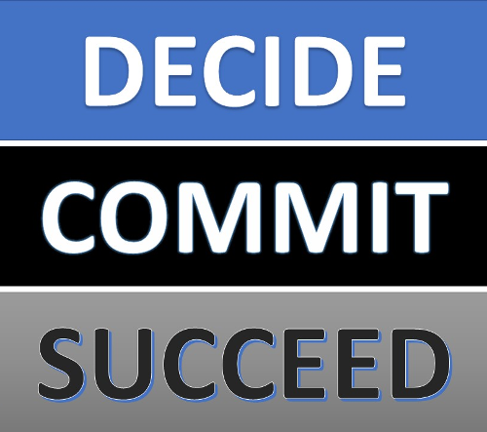
Your project will be split into a number of sprints.
In each sprint you will plan what you want to deliver within a couple of weeks of development effort.
I will ask you to commit to delivering the planned functionality within that sprint.

Slide 7

Potentially Shippable
Increments

Slide 8

Each sprint should result in a potentially shippable increment – i.e. something the client would pay money for.
This significantly reduces project risk and helps the client gauge progress (it doesn’t all happen at the end of project).
You should ensure that each sprint provides additional code that will attract marks. Doing so will reduce the project risk – a working game emerges and doesn’t all come together at the end.

Slide 9
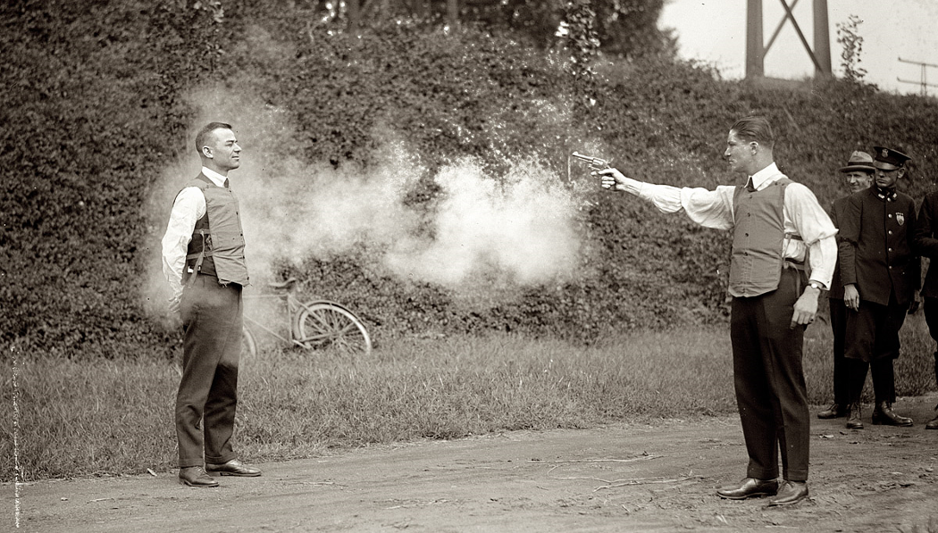
Bullet Proof

Slide 10

Saying a piece of development is ‘done’ doesn’t necessarily mean it has been tested, or fully commented, or accepted by the product owner. It often just means it has been developed.
Agile approaches often require a Definition of Done (DoD) to be established. It is often taken to mean ‘ready to deploy to production’.
In this project, you should ensure that functionality is only considered ‘done’ when it has been fully tested (functional, integration and acceptance).
“Working software is the primary measure of progress.”

Slide 11

Key takeaways:
Commit to delivering the agreed functionality within each sprint.
Make sure that each sprint provides new game features that will attract marks.
Ensure that functionality is only considered ‘done’ when it has been fully tested.

